Slide 2
PnP Controls for SPFx
Siddharth Vaghasia
https://github.com/siddharth-vaghasia
https://github.com/siddharth-vaghasia/public-docs

Slide 3







Siddharth Vaghasia
Technical Consultant – M 365, SharePoint, .NET
Speaker | Blogger | PnP Contributor
https://www.siddharthvaghasia.com
https://www.c-sharpcorner.com/members/siddharth-vaghasia
https://github.com/siddharth-vaghasia/
https://sharepoint.stackexchange.com/users/38824/siddharth-vaghasia
siddh.vaghasia@gmail.com
siddharthvaghasia
@siddh_me
siddharth.vaghasia

Slide 4
A little about PnP initiative
PnP controls
Content React controls
Property pane controls
Demos
QnA

Slide 5

About PnP Initiative
https://pnp.github.io/
Learn. Reuse. Share.
Sample and solutions
Best Practices Guidance documentation
Owned by SharePoint Engineering Team
Provides
M 365 Community Calls
Support of community
Tools
SDKs

Slide 6
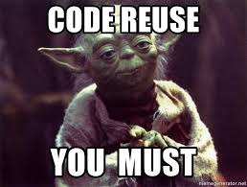
About PnP controls.
Reusable components
Open source library
Made for SPFx solutions
Owned by SharePoint engineering team
Developed and supported by community
Provides OOTB UI experience
Office UI based REACT additional controls.
SharePoint context driven
Extensible events

Slide 7
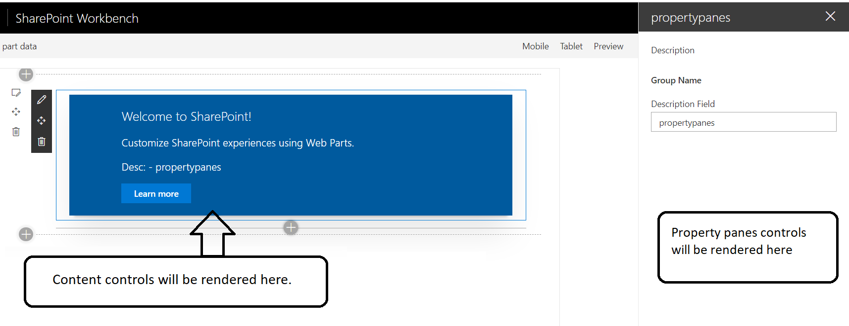
Types of controls

Slide 8




Types of controls
React controls – to be used in web parts and extensions
npm install @pnp/spfx-controls-react --save --save-exact
PnP Property pane controls – to be used in property panes
npm install @pnp/spfx-property-controls --save --save-exact

Slide 9
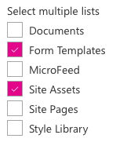
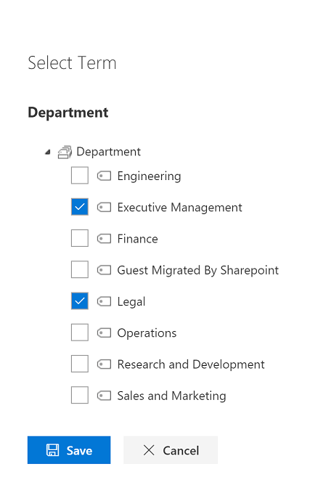
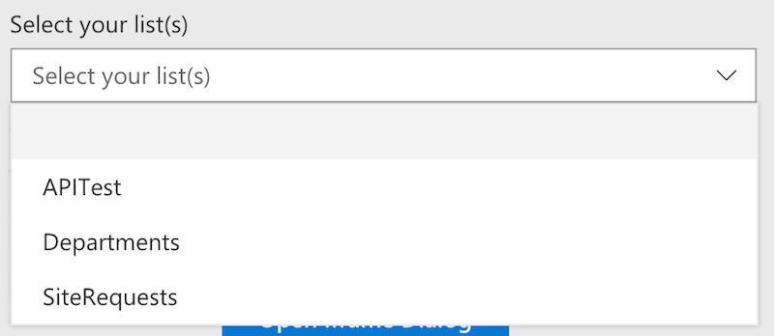
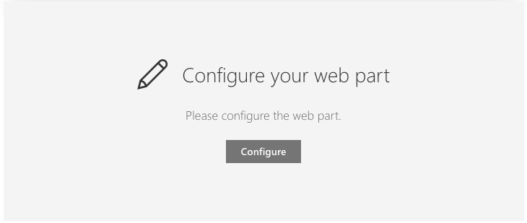
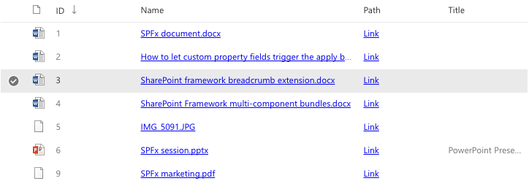
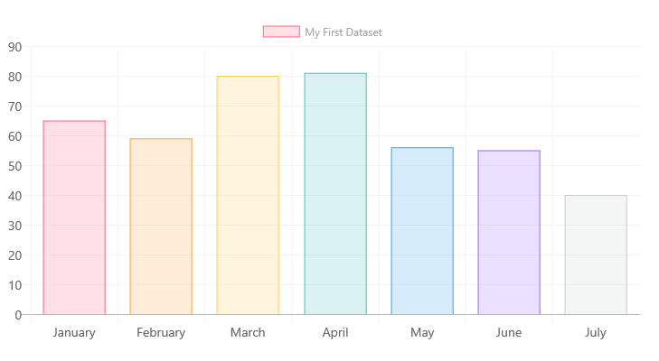
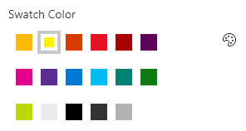
Some controls

Slide 10
List of react content controls
https://sharepoint.github.io/sp-dev-fx-controls-react/
Carousel
Charts
ComboBoxListItemPicker
DateTimePicker
FilePicker
FileTypeIcon
FolderExplorer
FolderPicker
IconPicker
GridLayout
SiteBreadcrumb
SecurityTrimmedControl
TaxonomyPicker
WebPartTitle
IFrameDialog
IFramePanel
ListItemAttachments
ListItemPicker
ListPicker
ListView
ListView: add a contextual menu
Map
Pagination
PeoplePicker - Available
Placeholder
Progress - Available
RichText
TreeView

Slide 11
Field Controls
“React controls that can be used in SPFx Field Customizers to provide rendering of the fields similar to out of the box experience.”
FieldRendererHelper
FieldAttachmentsRenderer
FieldDateRenderer
FieldFileTypeRenderer
FieldLookupRenderer
FieldNameRenderer
FieldTaxonomyRenderer
FieldTextRenderer
FieldTitleRenderer
FieldUrlRenderer
FieldUserRenderer

Slide 12
List of PnP Property Pane controls
https://pnp.github.io/sp-dev-fx-property-controls
PropertyFieldCodeEditor
PropertyFieldCollectionData
PropertyFieldColorPicker
PropertyFieldDateTimePicker
PropertyFieldEnterpriseTermPicker
PropertyFieldListPicker
PropertyFieldMultiSelect
PropertyFieldNumber
PropertyFieldPassword
PropertyFieldOrder
PropertyFieldPeoplePicker
PropertyFieldSitePicker
PropertyFieldSpinButton
PropertyFieldSwatchColorPicker
PropertyFieldTermPicker
PropertyPanePropertyEditor
PropertyFieldViewPicker
PropertyPaneWebPartInformation

Slide 13

Demos
Property pane controls
Multi select
Color Picker
React controls
Taxonomy picker
File Picker
Tree View
List view(content) with configure list(property pane)
List view
List Picker
Code Walkthrough SPFx form adding data to 2 lists
People Picker
List Item picker
List view(custom data source)
Office UI fabric controls – Dialog, Date Picker
Go to Demo Project
Go to Asset Request Project

Slide 14
Why would I use them?
When you want SharePoint seamless UI experience in custom webparts
Don’t have to reinvent wheel
Ease of use
Accelerate our development
SharePoint specific controls
Can be extended
Controls coming from first party SharePoint solutions.

Slide 15
When to use what?
Fluent UI (Office Fabric Controls)
PnP Reusable Controls
DIY(Build yourself)

Slide 16

Resources
Reusable controls (React)
https://github.com/SharePoint/sp-dev-fx-controls-react
https://sharepoint.github.io/sp-dev-fx-controls-react/
Reusable property pane controls (React)
https://github.com/SharePoint/sp-dev-fx-property-controls
https://sharepoint.github.io/sp-dev-fx-property-controls/
PnPJS
https://github.com/pnp/pnp
https://pnp.github.io/pnp/
Web Part samples
https://github.com/SharePoint/sp-dev-fx-webparts
Extension samples
https://github.com/SharePoint/sp-dev-fx-extensions

Slide 17
Inspiration
Vesa Juvonen - @vesajuvonen
Elios Struyf - @eliossstruyf
Andrew Connell - @andrewconnell
Joel Rodrigues - @joelFMRodrigues
https://github.com/joelfmrodrigues/demos/tree/master/PnP%20Controls
https://joelfmrodrigues.wordpress.com/2018/03/20/pnp-reusable-controls-property-pane-controls-and-pnpjs-library/
https://www.voitanos.io/blog/webinar-using-reusable-pnp-controls-in-spfx-projects-with-mvp-elio-struyf
https://www.youtube.com/watch?v=jefLhMdHv50
https://www.youtube.com/watch?v=D0ZOgoSpy28

Slide 19
Library Components in SPFx
By Nanddeep Nachan on 16th May 6 to 7 PM (IST)

